Slide 1

Unit-3 Views & Helpers
ASP.NET Core
#2301CS412
Prof. Naimish R. Vadodariya
Computer Science & Engineering Department
Naimish.vadodariya@darshan.ac.in
8866215253

Slide 2

Looping
Outline
Introduction to Views
Advantages of Views
Types of Views
Partial Views
Layout Pages
Tag Helpers
HTML Helpers
URL helpers
Custom Tag Helpers

Slide 3


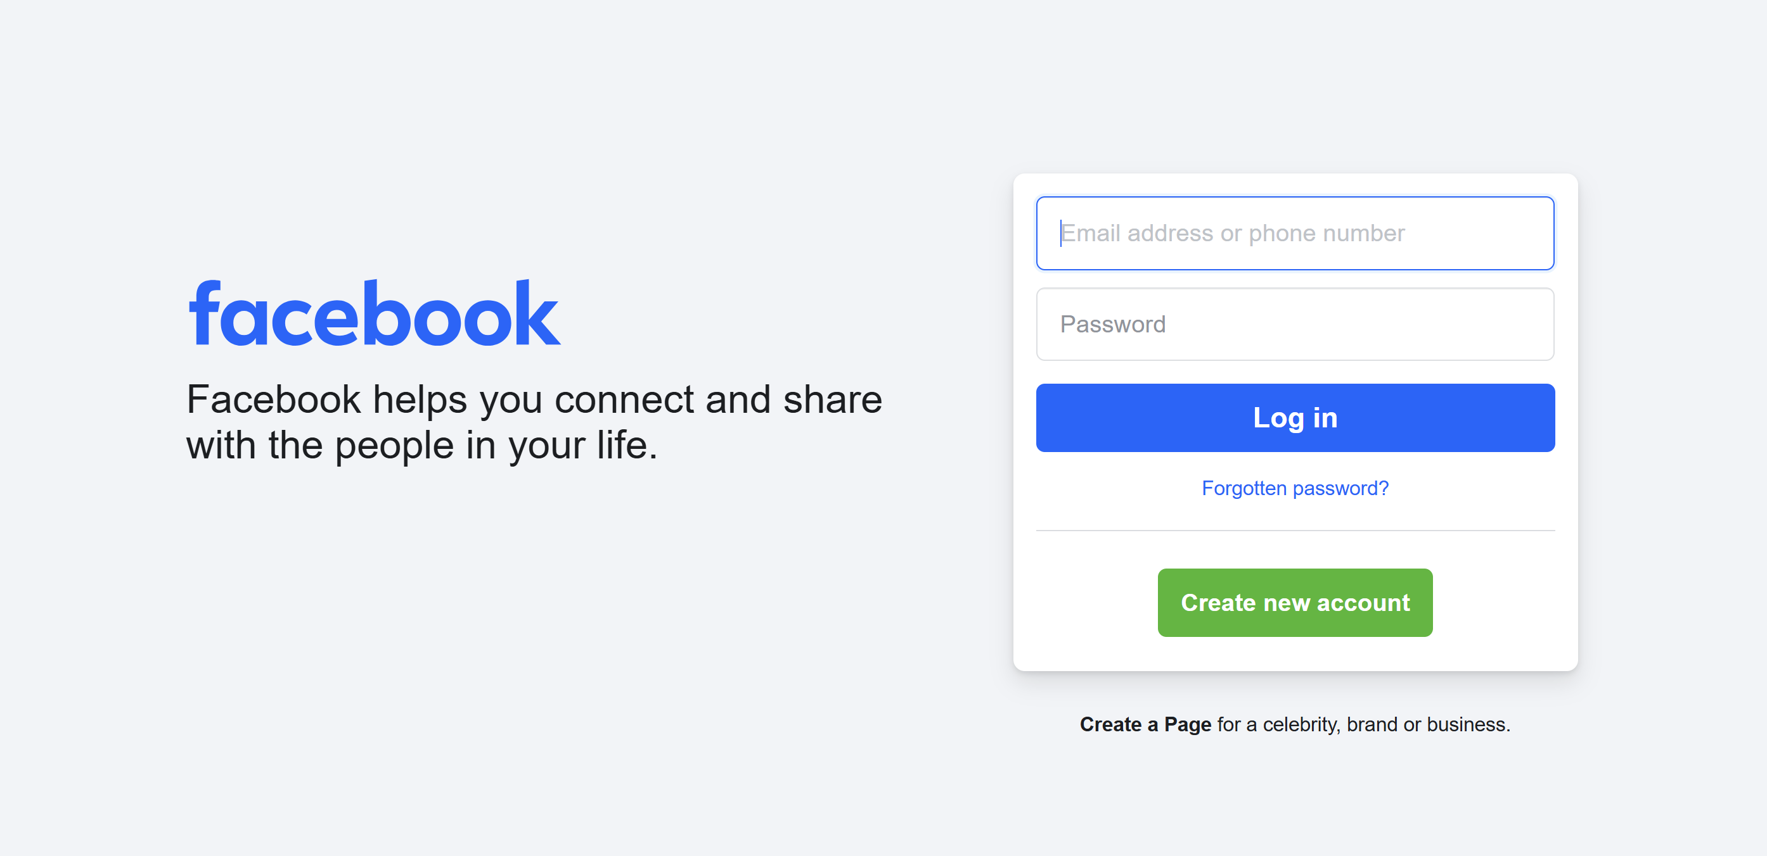
Views (Designs)
Section – 3.1

Slide 4
Introduction : Views in MVC
The Views in ASP.NET Core MVC are the design pages of any website or application.
A view is a file with a “.cshtml” (for C# language) extension. [AboutUs.cshtml, ContactUs.cshtml etc.]
The meaning of cshtml is CS (C Sharp) + HTML.
That means the view is a combination of programming language (C#) and HTML (Hypertext Mark-up Language).
A view in ASP.NET Core MVC Application is responsible for UI i.e. User Interface.
A user generally performs all the actions on a view such as a button click, forms, list, and other UI elements.
That means we can display information about the application on the browser using the views only.
By default, Views are available inside the Views folder at the root.

Slide 5
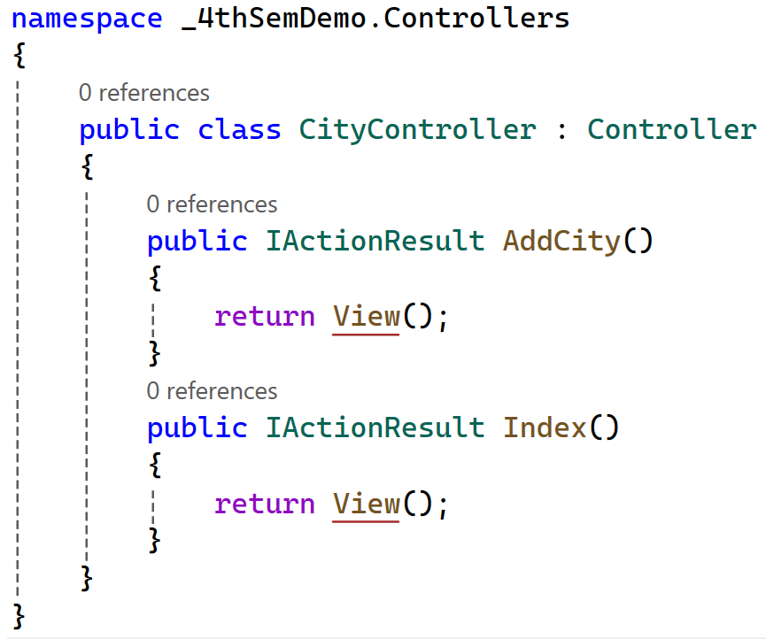
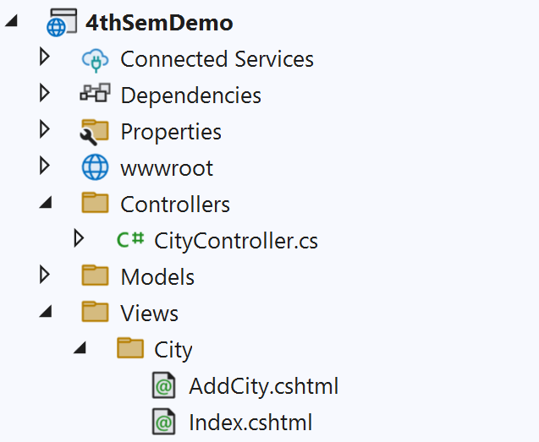
Introduction : Views in MVC Cont..
View file name is the same as the action method name of a controller with the “.cshtml” extension.
For example, if the controller action method is Index, the view file would be Index.cshtml.

Slide 6
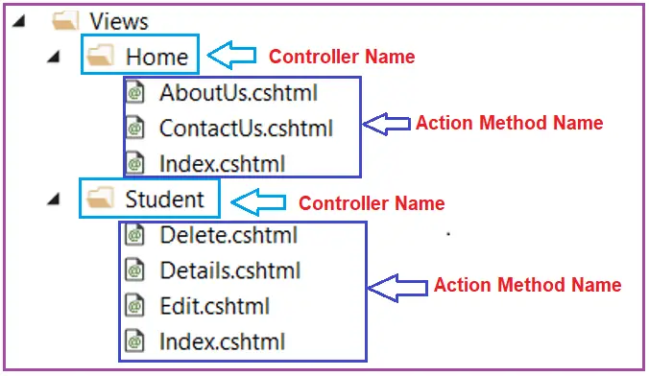
Views: Example
Let’s say, we have an ASP.NET Core MVC application with two controllers
i.e. HomeController and StudentController.
The HomeController is created with the following three action methods.
AboutUs()
ContactUs()
Index()
On the other hand, the StudentController is created with the following four action methods.
Delete()
Details()
Edit()
Index()
Views
Views

Slide 7
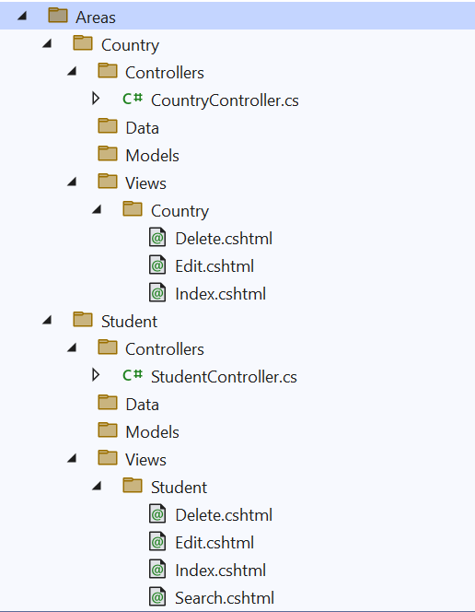
Views with Area : Example
Let’s say, we have an ASP.NET Core MVC Areas.
i.e. Areas created as Country and Student.
The Country Area is with the following three action methods in their Views.
Delete()
Edit()
Index()
The Student Area is with the following four action methods in their Views.
Delete()
Edit()
Index()
Search()
Country Area
Views
Student Area
Views

Slide 8
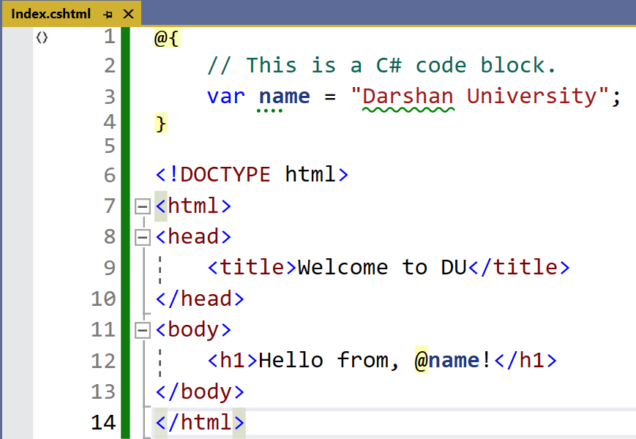
View (Code) : Example
C#
HTML

Slide 9

Guess the Views of Student Management System Project!!!
Student
Student List
Student Add
Student Edit
Student View
Student Timetable
Student Fees
Student Assignment
Student Result

Slide 10
Advantages of Views (Why Views?)
Views are an important part of the ASP.NET Core MVC framework.
They allow you to separate the presentation layer of application from the business logic and data access layers.
With the help of views, application is easy to maintain and develop (Different Screens).
Separation of concerns:
Views are responsible for the presentation layer of the application, while controllers are responsible for the business logic and data access layers.
Reusability:
Views can be reused in different parts of the application.
This can save time and effort when developing the application.
Flexibility:
Views can be customized to meet the specific needs of the application.
This makes the application more flexible and adaptable.

Slide 11
Remember!!!
Adding a View
Click on your Views Folder, Inside Views folder there is controller specific folder 📁.
On that specific controller folder 📁, right click on it and go to Add→View→Razor View – Empty.
Give view name and press Add.
Searching View Behavior
The default behavior of the View method (i.e., return View();) is to return a view with the same name as the action method name from which it is being called.
For example, the Index ActionResult method of the Home controller is used to search for a view file with the name Index.cshtml in the following two locations.
First, it will look for the “Index.cshtml” file within the /Views/Home, i.e., Views/[ControllerName] folder, as the action method belongs to Home Controller.
Then it will look for the “Index.cshtml” file in the “/Views/Shared/” folder.
Then it will look for the “Index.cshtml” file in the “/Pages/Shared/” folder.

Slide 12
Different Types of Razor View Files in Project
Section – 3.2

Slide 13
Different Types of Razor View Files in Project
All Razor files ends with .cshtml.
Most of Razor files are intended to be browsable and contains a mixture of client-side and server-side code, when it is processed, results in HTML being sent to the browser.
These pages are usually referred to as "content pages".
Also other Razor files have a leading underscore (_) in their file name like _Layout.cshtml , _ViewStart.cshtml, _ViewImports.cshtml etc.
The leading underscore in the file name indicates that these files are not intended to be served directly by the browser.

Slide 14
Different Types of Razor Files
Razor files are used in ASP.NET Core to create dynamic web pages with a mix of HTML and C# code. Here are the different types of Razor files:
Content Pages:
These are the most common Razor files, ending with .cshtml.
They contain a mix of client-side and server-side code, which results in HTML being sent to the browser.
Partial Pages:
These files also end with .cshtml but have a leading underscore (e.g., _Partial.cshtml).
They are not intended to be browsable directly and are used to include reusable components in other pages.
Layout Pages:
The _Layout.cshtml file acts as a template for other content pages.
It typically includes the site’s header, footer, and navigation, ensuring a consistent design across the site.
View Start Pages:
The _ViewStart.cshtml file contains code that runs before any content page in the same folder or subfolders.
It’s often used to specify the layout file for all affected content pages.
View Imports Pages:
The _ViewImports.cshtml file is used to include directives that should be available to all Razor pages in a folder hierarchy, such as namespaces and tag helpers.

Slide 15
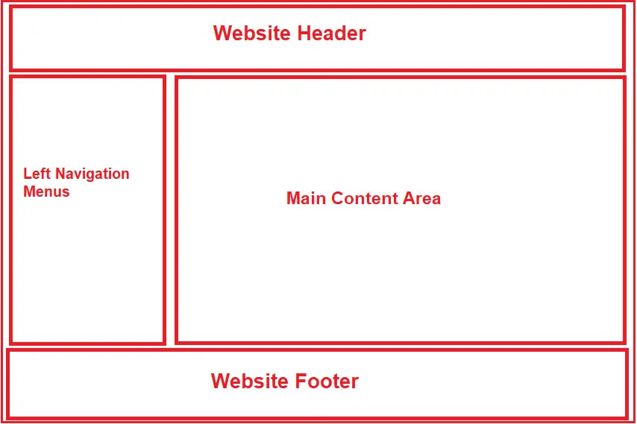
_Layout.cshtml
The _Layout.cshtml file acts as a template for all content pages that reference it.
Consistent part of a site's design are declared in the _Layout.cshtml file.
These can include the header, footer, site navigation, main content area and so on.
Typically, the _Layout.cshtml file also includes the <head> section of the page, so they also reference the common CSS style sheet files and JavaScript files.
If you want to make changes to the overall design of the site, you often only need to make adjustments to the content of the _Layout.cshtml.
In ASP.NET Core MVC, creating multiple layout files for a single application is possible.
For example, you may have one layout file for the admin users and another layout file for non-admin users of your application.

Slide 16
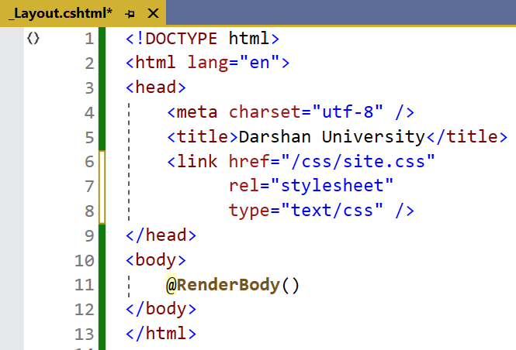
_Layout.cshtml
We can say that the common UI code, which can be used in many views, can go into a common view called _Layout in application.
As the layout views are not specific to any controller.
As the layout view will be used across multiple views of our application, we usually place the layout views in a Shared subfolder within the Views folder.
By default, in ASP.NET Core MVC App, the layout view file is named _Layout.cshtml. But you can change the name if you wish.

Slide 17
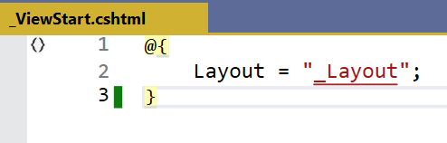
_ViewStart.cshtml
The _ViewStart.cshtml file contains code that executes after the code in any content page in the same folder or any child folders.
It provides a convenient location to specify the layout file for all content pages that are affected by it, and that is typically what you see in the _ViewStart.cshtml file that comes with any Razor Pages (or MVC) template.

Slide 18
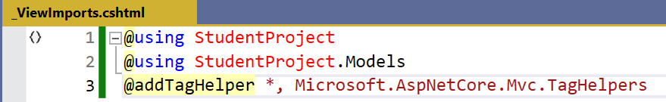
_ViewImports.cshtml
It is a special Razor view file that allows us to specify the common namespaces, directives, and other elements, that will be automatically imported and applied to all views within a specific directory and its subdirectories.
It helps us to simplify the Razor syntax and reduce repetitive code by centralizing the import statements in one place.

Slide 19
Partial Views
Section – 3.3

Slide 20
Introduction : Partial View
Partial Views in ASP.NET Core MVC are used to render a portion of the view content.
They help in breaking down large views into smaller, reusable components, promoting maintainability and reducing code duplication.
A partial view is a regular view but it can be used multiple times in an application and it has the file extension similar to view as .cshtml.
We need to create a partial views when we need a common part of the user interface on multiple pages in our web application.
Sometimes we also use a partial view to divide a web page into small parts such as header, footer, and menu on Layout.
Partial Views are the views that are rendered within another view and do not run on their own.
Often start with an underscore (e.g., _PartialView.cshtml), though not mandatory.

Slide 21
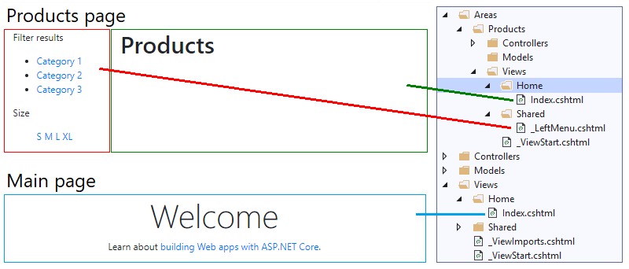
Partial View Example

Slide 22
Views v/s Partial Views
Views | Partial Views
View contains the layout page | Partial View does not contain the layout page
Before any view is rendered, viewstart page is rendered | Partial view does not verify for a viewstart.cshtml page
View might have markup tags like body, html, head, title, Meta etc. | Partial view is designed specially to render within the view and just because of that it does not consist any mark up tag
View is not lightweight as compare to Partial View | Partial view is lightweight
A "View" in the context of web development typically refers to the template or markup that defines the structure and presentation of the entire page. | Partial view is a reusable piece of a view that can be included in multiple views.
Views are typically rendered as complete pages. | Partial Views are embedded within views and can be dynamically loaded or included where needed.
Views are typically not as reusable as partial views because they often encapsulate a specific page's structure and content. | Partial Views are designed for reusability, you can include the same partial view in multiple views to maintain consistent UI elements across different parts of your application.

Slide 23
Tag Helpers
Section 3.4

Slide 24
Tag Helpers
Tag Helpers are classes written in C# but are attached to HTML elements in order to run server-side code from Razor view.
It enable server-side code to participate in creating and rendering HTML elements in Razor files.
There are many built-in Tag Helpers for common tasks, such as creating forms, links, loading assets etc.
Tag Helpers are authored in C#, and they target HTML elements based on the element name, the attribute name, or the parent tag.
For example, the built-in LabelTagHelper can target the HTML <label> element when the LabelTagHelper attributes are applied.
If you are familiar with HTML Helpers, Tag Helpers reduce the explicit transitions between HTML and C# in Razor views.

Slide 25
Using a Tag Helpers
To use the inbuilt or custom Tag Helpers, one has to first reference Tag Helper library named Microsoft.AspNetCore.Mvc.TagHelpers.
It can also be taken from Nuget.
It using @AddTagHelper directive as shown below inside _ViewImports.cshtml,
In the above line, all the Tag helpers will be imported which are mentioned in 'Microsoft.AspNetCore.Mvc.TagHelpers' assembly.
Whatever it is referenced/imported inside _ViewImports.cshtml will be available for all the views.

Slide 26
Common Built-in Tag Helpers
These Tag Helpers are provided by default as part of the ASP.NET Core framework.
They cover common scenarios and tasks, making generating HTML with dynamic behavior easier, such as generating links, creating forms, loading assets, showing validation messages, etc. Some examples of built-in Tag Helpers include:
<a asp-controller=”Home” asp-action=”Index”>Link</a>: Generates a link with a URL that’s generated by routing based on the specified controller and action.
<img src=”~/images/pic.jpg” asp-append-version=”true” />: Generates a <img> tag with a cache-busting query string to ensure the latest version of the image is fetched.
<form asp-controller=”Account” asp-action=”Login” method=”post”>…</form>: Generates a form element with the appropriate action attribute for the specified controller and action.
<input asp-for=”Username” />: Generates an input field with attributes based on the model property specified by asp-for.
<span asp-validation-for="Username" class="text-danger"></span>: Generates a username validation message with specified control.

Slide 27
Built-in Tag Helpers Cont..
Attribute | Asp Attribute Name | Description
area | asp-area | The name of the Area
controller | asp-controller | The name of the MVC controller
action | asp-action | The name of the action method on an MVC controller
route | asp-route | The name of the route
route- | asp-route-* | A single route parameter value
Fragment | asp-fragment | This is particularly useful when you want to link to a specific section of a page.

Slide 28
HTML Helpers
Section 3.5

Slide 29
Introduction: HTML Helpers
HTML Helpers are classes that can generate html tags in Razor view pages.
An HTML Helper is just a method that returns a HTML string.
The string can represent any type of content that you want.
For example, you can use HTML Helpers to render standard HTML tags like HTML <input>, <button> and <img> tags etc.
It also binds the model object to HTML controls to display the value of model properties into those controls and also assigns the value of the controls to the model properties while submitting a web form.
So, we can always use the HtmlHelper class in razor view instead of writing HTML tags manually.
Starts with @Html is an object of the HtmlHelper class. (@ symbol is used to access server-side object in razor syntax)

Slide 30
Built-In HTML Helpers
Standard Html Helpers
Strongly Typed HTML Helpers (Model Binding)

Slide 31
Standard HTML Helpers
Section 3.6

Slide 32
1. Standard HTML Helpers
HTML Element | Example
TextBox | @Html.TextBox("txtLastName", “Last Name")
TextArea | @Html.TextArea("txtAddress", "Enter Address", 5, 15, null)
Password | @Html.Password("txtPassword", "123")
Hidden Field | @Html.Hidden("Hidden1", "val")
CheckBox | @Html.CheckBox("Checkbox1", false)
RadioButton | @Html.RadioButton("Radiobutton1", "val", true)
Drop-down list | @Html.DropDownList("DropDownList1", new SelectList(new [] {"Male", "Female"}))
Multiple-select | @Html.ListBox("ListBox1", new MultiSelectList(new [] {"Cricket", "Chess"}))
ActionLink | @Html.ActionLink("Click here", // <-- Link text "About", // <-- Action Method Name "Home", // <-- Controller Name null, // <-- Route value null // <-- html Arguments )

Slide 33
Strongly Typed HTML Helpers
Section 3.7

Slide 34
2. Strongly Typed HTML Helpers
HTML Element | Example
TextBoxFor | @Html.TextBoxFor(m=>m.Name, new {@class="form-control",@placeholder="Enter User Name",@style="color:red"})
TextAreaFor | @Html.TextAreaFor(m=>m.Address, 5, 15, new{}))
PasswordFor | @Html.PasswordFor(m=>m.Password)
HiddenFor | @Html.HiddenFor(m=>m.StudentId)
CheckBoxFor | @Html.CheckBoxFor(m=>m.IsDetained)
RadioButtonFor | @Html.RadioButtonFor(m=>m.IsDetained)
DropDownListFor | @Html.DropDownListFor(m => m.Gender, new SelectList(new [] {"Male", "Female"}), “Select Gender")
ListBoxFor | @Html.ListBoxFor(m => m.Hobbies, new MultiSelectList(new [] {"Cricket", "Chess“,”Music”}))

Slide 35
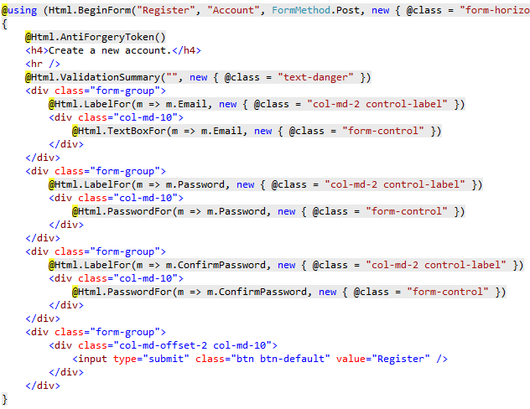
Example: Strongly Typed HTML Helpers

Slide 36
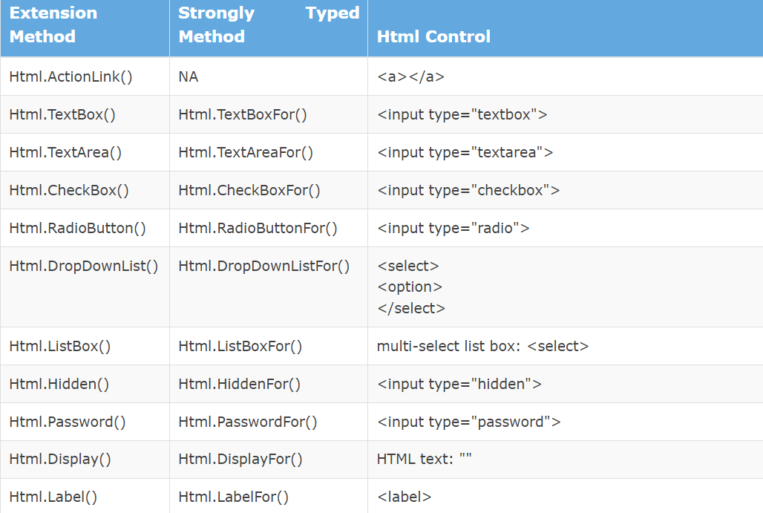
Summary

Slide 37
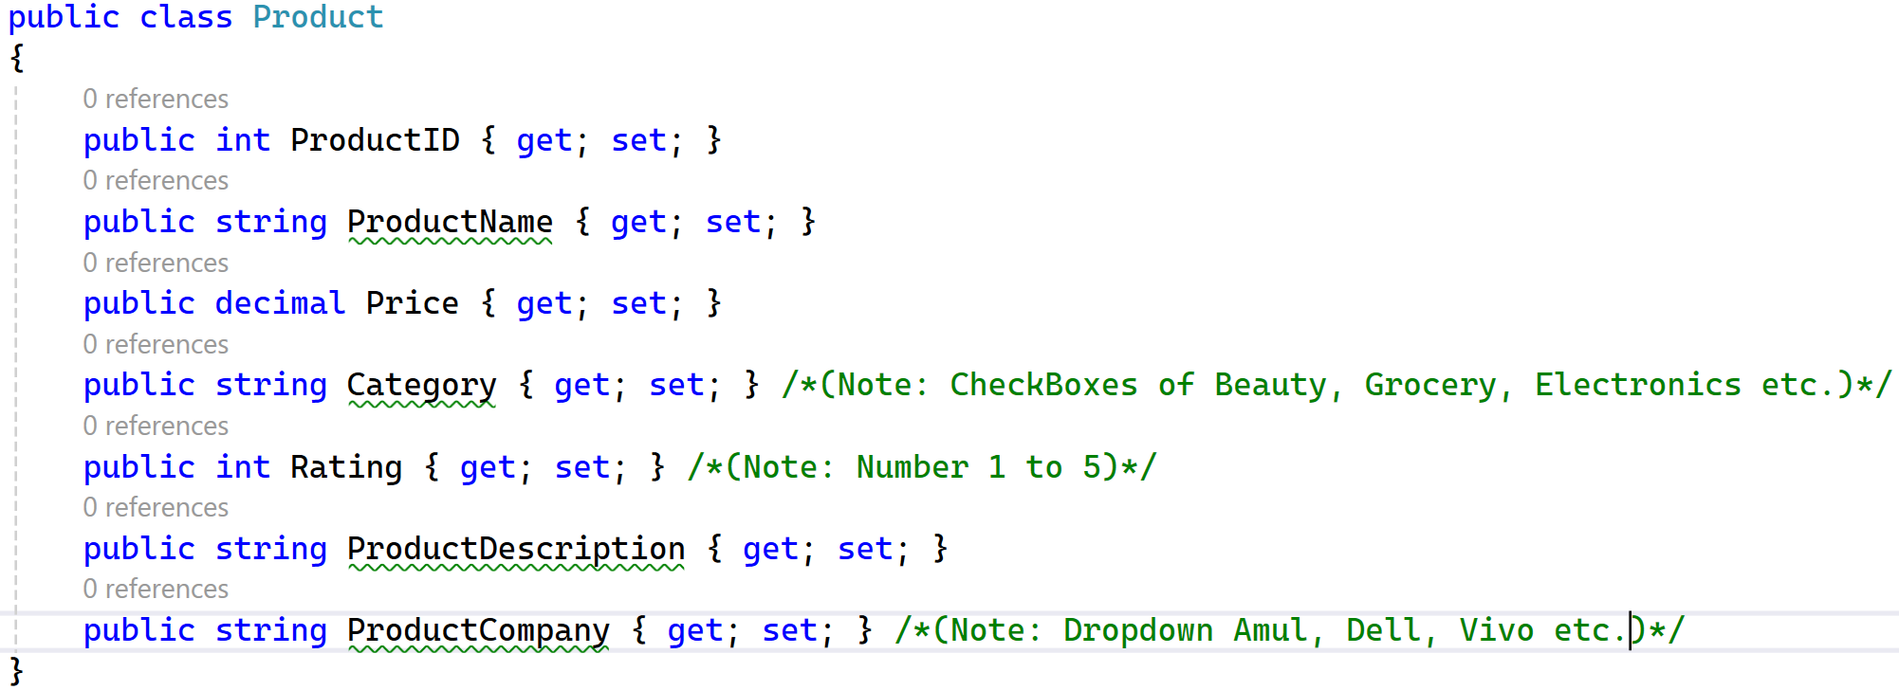
Practice: Create a Form With Strongly Typed HTML Tag Helper

Slide 38
Difference Between Standard HTML Helpers, Strongly Typed HTML Helpers and Tag Helpers
Aspect | Tag Helpers | Standard HTML Helpers | Strongly Typed HTML Helpers
Syntax | HTML-like with Razor attributes | C# method calls | C# method calls with lambda
Model Binding | Direct (e.g., asp-for) | Manual | Automatic with lambda
Validation Integration | Automatic | Manual | Automatic
Readability | High | Low | Medium
Debugging | IntelliSense-supported | No IntelliSense | IntelliSense-supported
Extensibility | High (custom tag helpers) | Low | Low
Best For | HTML-like syntax and simplicity | Basic HTML generation | Strong model integration

Slide 39
Anchor Tag Helpers
Section 3.8

Slide 40
Anchor Tag Helper
This tag helper is used generate href attributes to link to a particular controller action or MVC route.
This tag helper is an alternative to using @Html.ActionLinkor @Url.Action helper methods.
For example, the following code in a Razor view:
@Html.ActionLink("Register Yourself","RegisterMethod", "Account") <a href="@Url.Action("RegisterMethod", "Account")">Register Yourself</a>
It will generate two identical anchor html tags.
<a href="/Account/RegisterMethod">Register Yourself </a> <a href="/Account/RegisterMethod">Register Yourself </a>
Using the anchor tag helper, we can generate the same HTML as above by adding the asp-controller and asp-action attributes to an anchor tag as follows:
<a asp-controller="Account" asp-action="RegisterMethod">Register Yourself</a>

Slide 41
Anchor Extension Methods Cont..
Using ActionLink
1
2
3
4
<p>This link is generated in the View:</p>
@Html.ActionLink("Simple link to a 'Home' controller 'Index' action",
“Index”, "Home")
</p>
Using Anchor Tag
1
2
3
4
5
<p>This link is generated in the View:</p>
<a asp-controller="Home"
asp-action="Index">Simple link to a 'Home' controller 'Index' action
</a>
</p>
Using URL Action
1
2
3
4
5
<p>This link is generated in the View:</p>
<a href="@Url.Action("Index", "Home")">
Simple link to a 'Home' controller 'Index' action
</a>
</p>

Slide 42
ActionLink Extension Method Cont..
Get a link to the current controller’s action
1
@Html.ActionLink("Link to Index action", "Index")
Get a link to specific controller and action:
1
@Html.ActionLink("Link to Index action of Home controller", "Index", "Home")
Get a link to specific controller and action with parameters
1
2
3
@Html.ActionLink("Link to Index action of Home controller with id=100500 and
name='John Doe'", "Index", "Home",
new { id = 100500, name = "John Doe" })
Get a link to specific controller and action and set css class for the link
1
2
3
4
@Html.ActionLink("Link to Index action of Home controller with id=100500 and
name='John Doe' and CSS class", "Index", "Home",
new { id = 100500, name = "John Doe" },
new { @class="css-class"})

Slide 43
Custom Tag Helpers
Section 3.9

Slide 44
Custom Tag Helpers
Custom Tag Helpers in ASP.NET Core MVC allow you to create reusable HTML elements that can be rendered dynamically in Razor views.
Tag helpers are an important feature of ASP.NET Core as they allow you to implement logic in HTML tags.
This helps to maintain clean and readable Razor views and makes it easy to reuse functionality across different views.
In order to use tag helpers in an application, we must make them available in our application by adding them with the @addTagHelper directive to our _ViewImports.cshtml file in the Views folder:

Slide 45
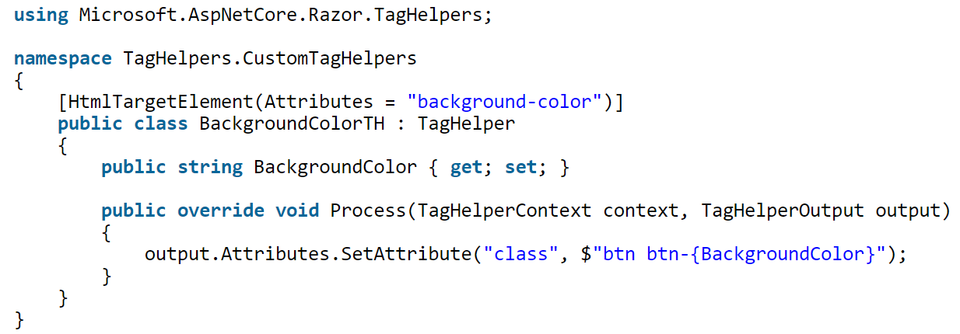
How to Create a Custom Tag Helper Class?
It’s a three-step process as follows:
Add a new class to your project
Inherit from TagHelper.
Override the Process or ProcessAsync method.
The attribute – [HtmlTargetElement(Attributes = "background-color")] on the class tells that this Tag Helper applies to those html element that have the attribute background-color on them.

Slide 46
Registering the Custom Tag Helper
The final part is registering your Custom Tag Helper in the ViewImports.cshtml file by adding the following code to it:
The first part TagHelpers.CustomTagHelpers.* specifies the namespace of the custom tag helper class followed by the wildcard character (*).
It means all the files inside the TagHelpers.CustomTagHelpers namespace.
The second part specifies the assembly name which is the name of the project.
Here the project name is TagHelpers and can be different in your case.

Slide 47
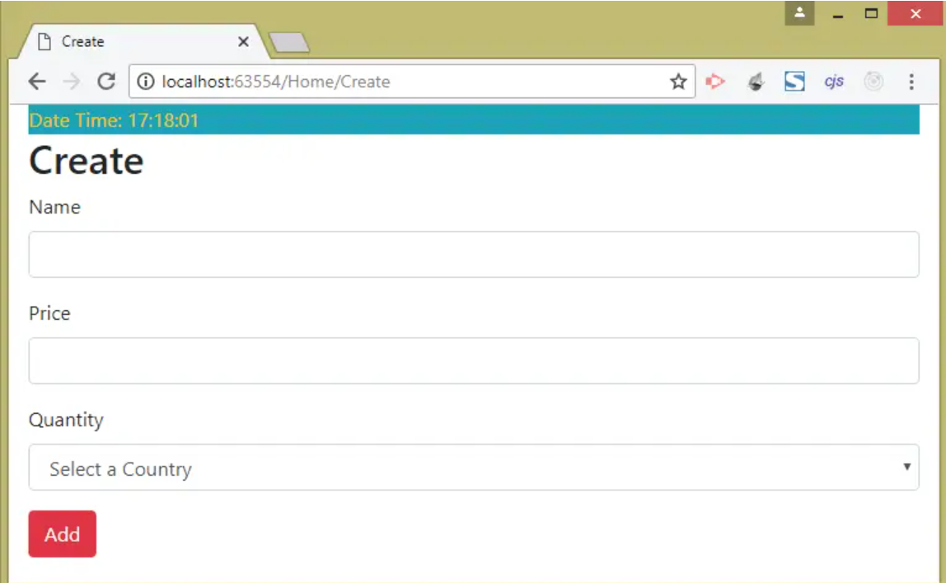
Using the Custom Tag Helper
So we go to the Create View of the Home Controller and replace the button with the following code:

Slide 48
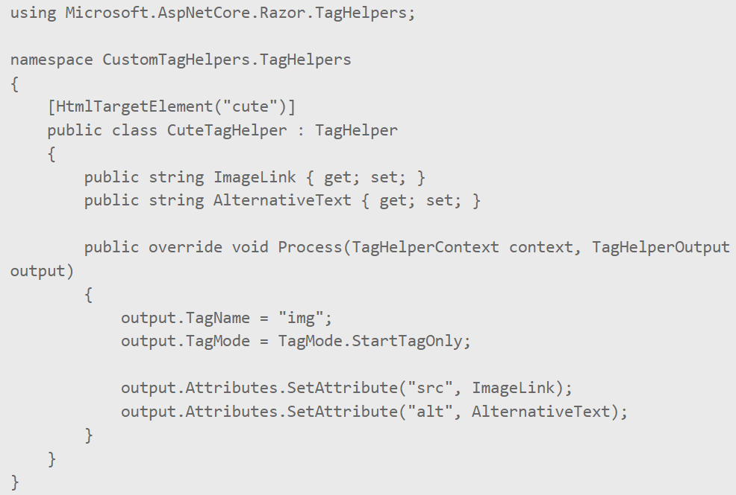
Custom Tag Helper - Example
<cute image-link=“” alternative-text=“”>

Slide 49
ASP.NET Core
#2301CS412
Prof. Naimish R. Vadodariya
Computer Science & Engineering Department
Naimish.vadodariya@darshan.ac.in
8866215253

